Slide 1


A general-purpose open-access repository
Shannon Syrstad, Utah Water Research Lab, Utah State University, Logan, UT

Slide 2
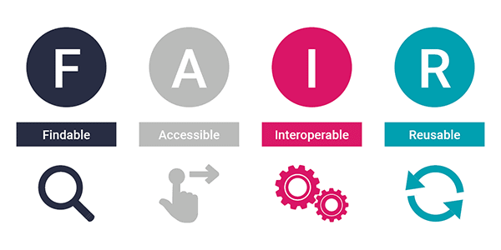
What is Zenodo?
Launched May 2013
Zenodo is a general-purpose open-access repository developed under the European OpenAIRE program (program supporting open science) and operated by CERN (OpenAIRE partner and pioneer in open source, open access and open data)
Accepts articles, images, posters, software, models, reports, and most importantly datasets
Supports all file formats
50GB per record (a record is the container or “resource”)

Slide 3
What are the benefits of Zenodo?
Data accessibility is up to user
  Options to control access rights, access conditions, etc
Track number of views and downloads
Data is assigned a DOI, digital object identifier
Data is easy to cite, share or discover
Data is preserved at the CERN data center
Free!

Slide 4
What are the downsides of Zenodo?
Users may not know to go to Zenodo to search for your data
Zenodo’s metadata is generic and not as flexible as other repositories, record specific not file specific metadata
There are no folder capabilities
Creative Commons Attribution license is the only open license available
Hard to add funding agency information if not in Zenodo’s database
Because of this, we want to encourage you to use Zenodo as a last resort!

Slide 5
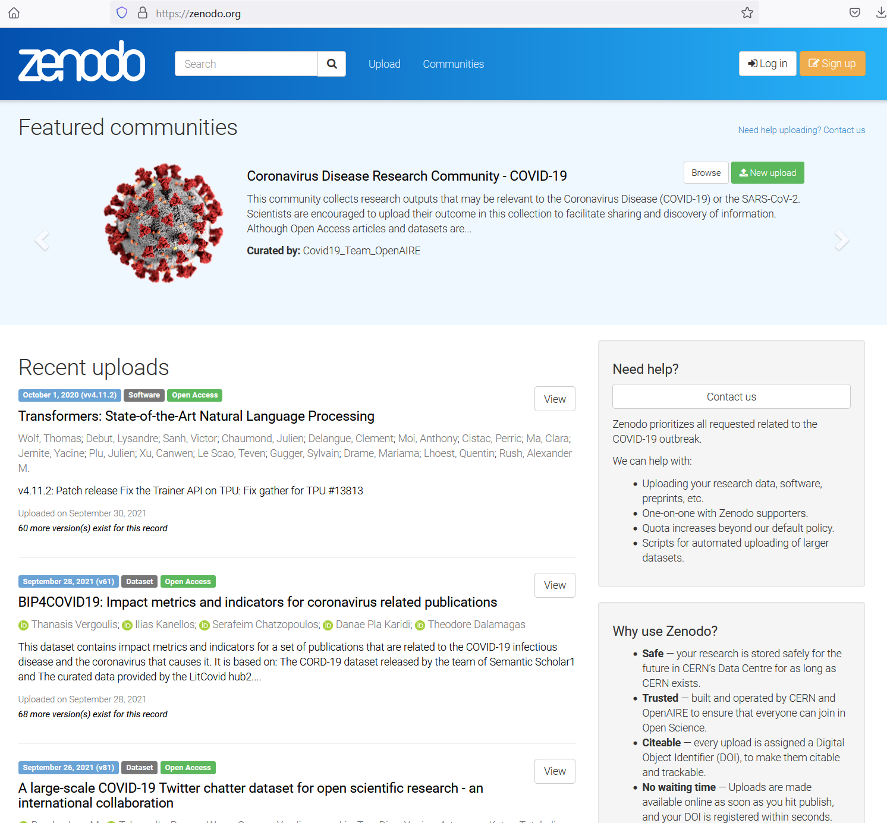

Slide 6
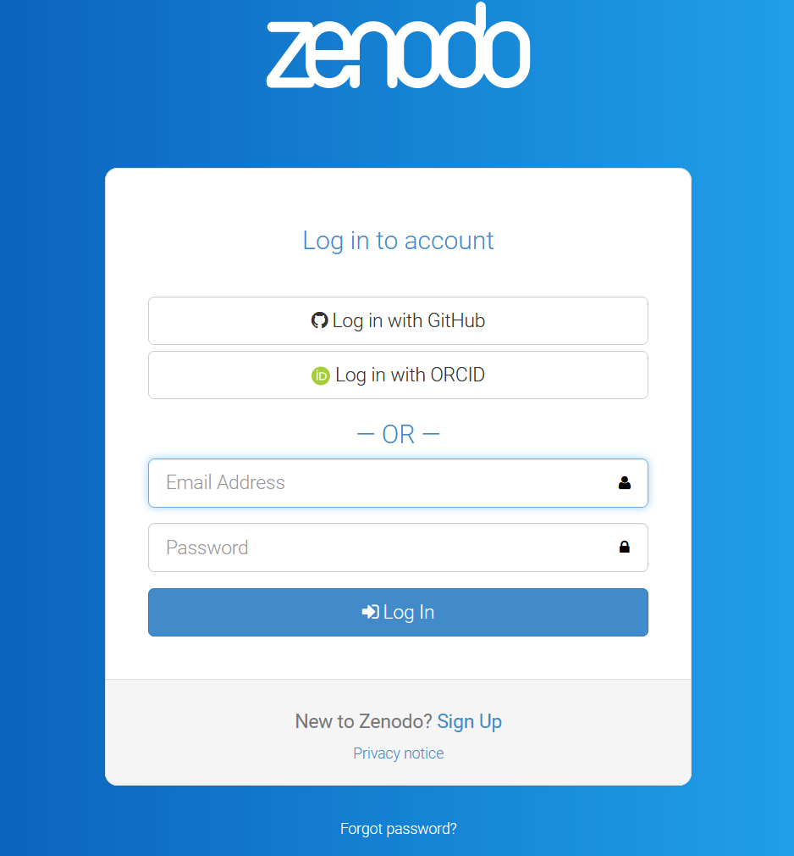
Sign Up / Sign In
Log in with ORCID
No ORCID? www.orcid.org to create an account
ORCID is needed for the Data Submission Portal as well

Slide 7
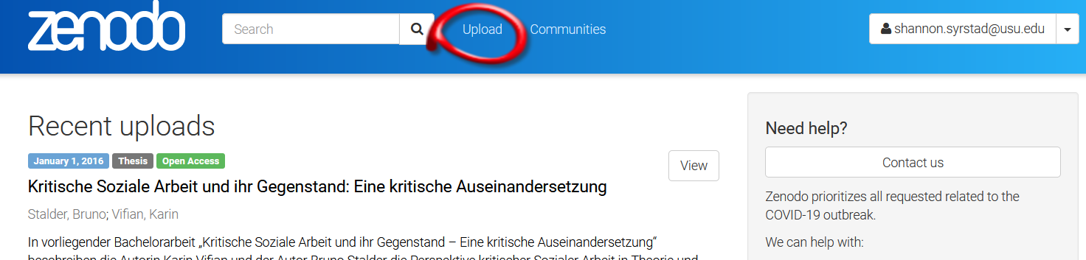
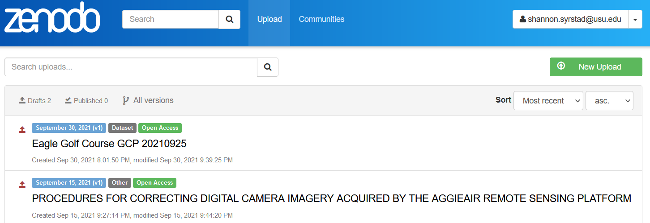

Slide 8
What is a Record?
A record is a “container” where you will put your content
Similar to a HydroShare resource
Upload any number or type of files
50GB limit per record
Metadata is applied at the record level, not the file level

Slide 9
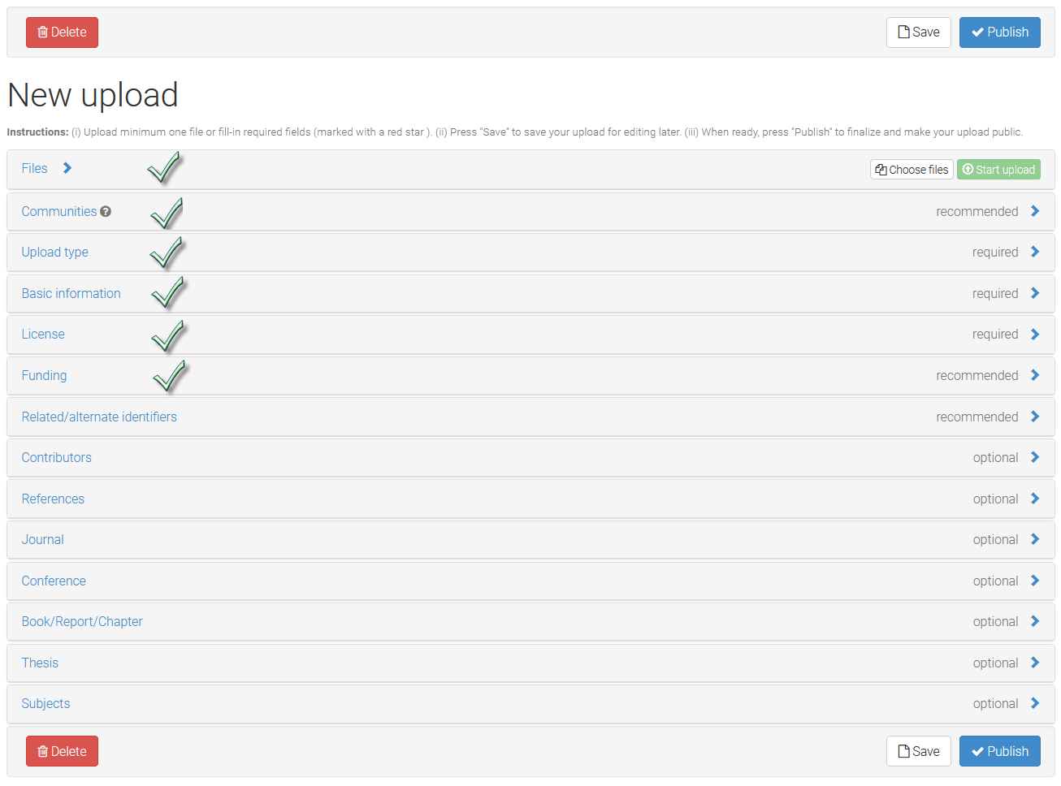

Slide 10
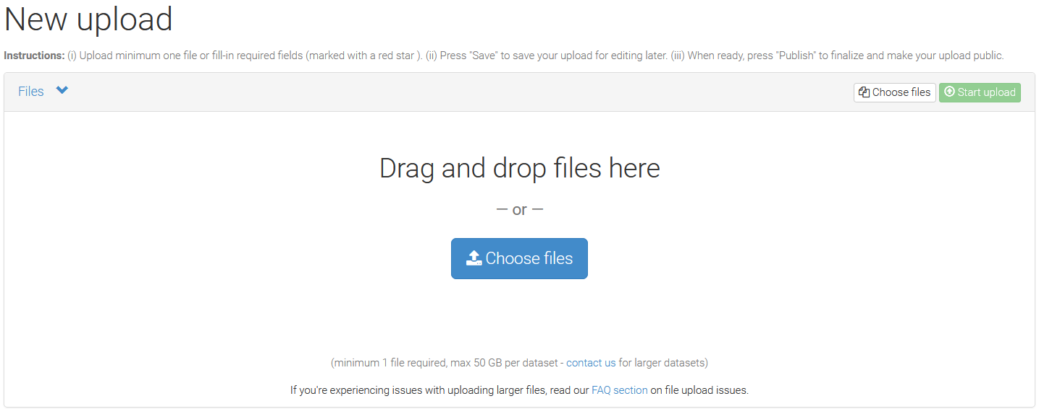
Add Datasets
Additional Files can be uploaded at a later date as long as it is still UNpublished

Slide 11
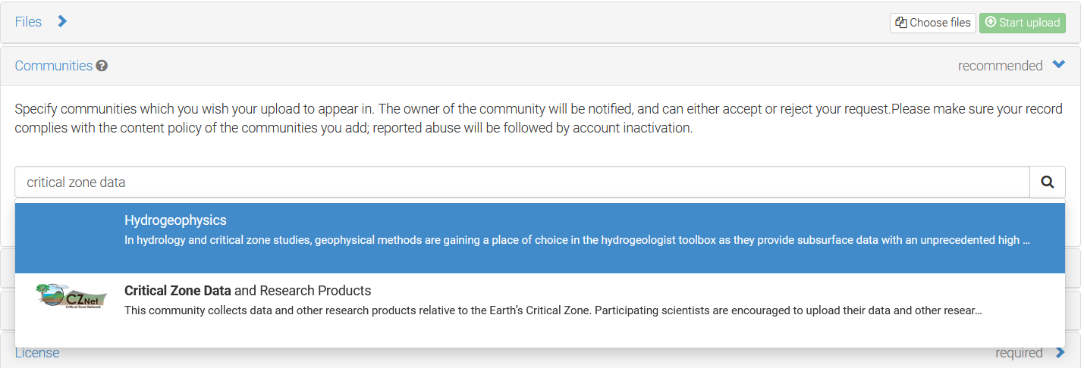
Required: Add Critical Zone Communities
Use all three words “critical zone data” for the community to pop up in Zenodo
Note: Critical Zone Data community not set up in Sandbox

Slide 12
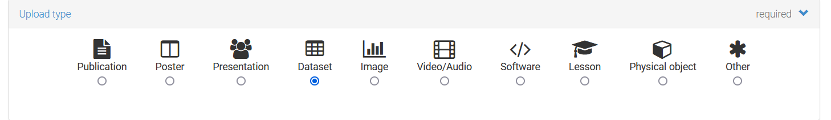
Required: Upload Type
If uploading different file types:
For CZ Net data, specifically use the dataset upload type
You may upload other content (posters, publications, presentations, etc) if you wish

Slide 13
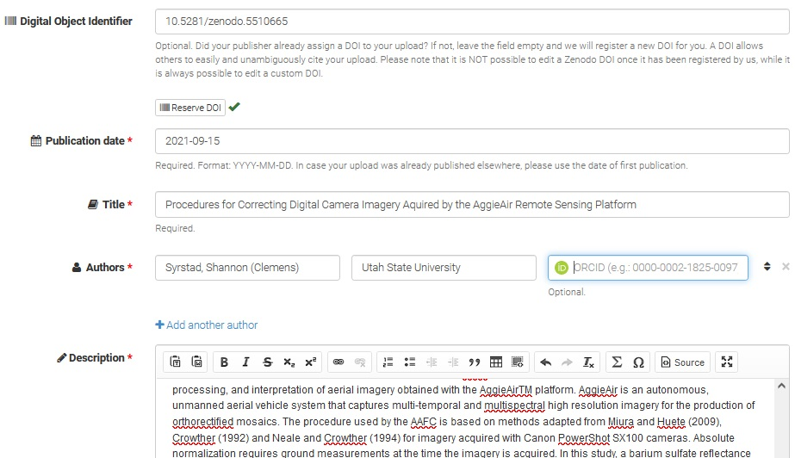
Required: Basic Information
Do not type in DOI box, Zenodo will populate
DOI is created when you reserve or publish
Publication Date - allow Zenodo to manage the date for you
Title - title is for entire upload, will affect discoverability of your dataset
Authors (use separate row for each author)
Description (abstract)

Slide 14
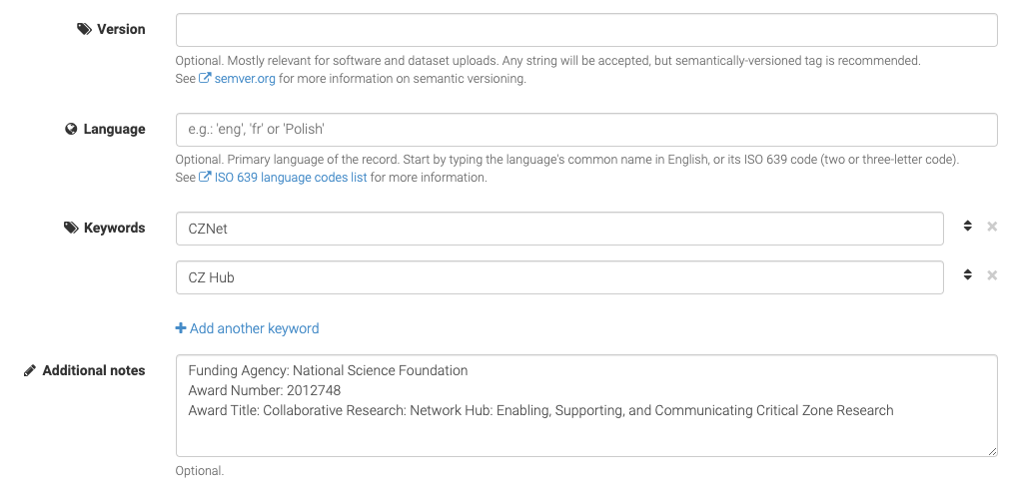
Basic Information continued…
Keywords: CZNet and your thematic cluster
Funding agency if not in database
Funding Agency:
Award Number:
Award Title:

Slide 15
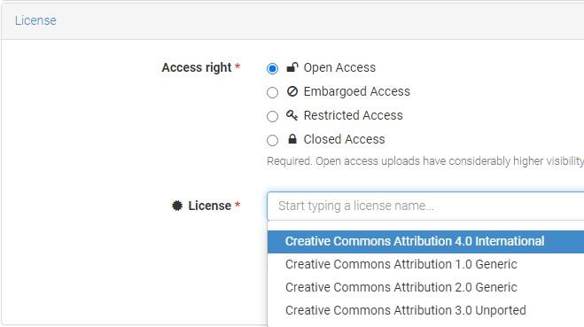
Required: License
Choose a license to let user know how they can use the data
Creative Commons Attribution 4.0 International enables other people to
Share — copy and redistribute the material in any medium or format
Adapt — remix, transform, and build upon the material for any purpose, even commercially
https://creativecommons.org/licenses/by/4.0/

Slide 16
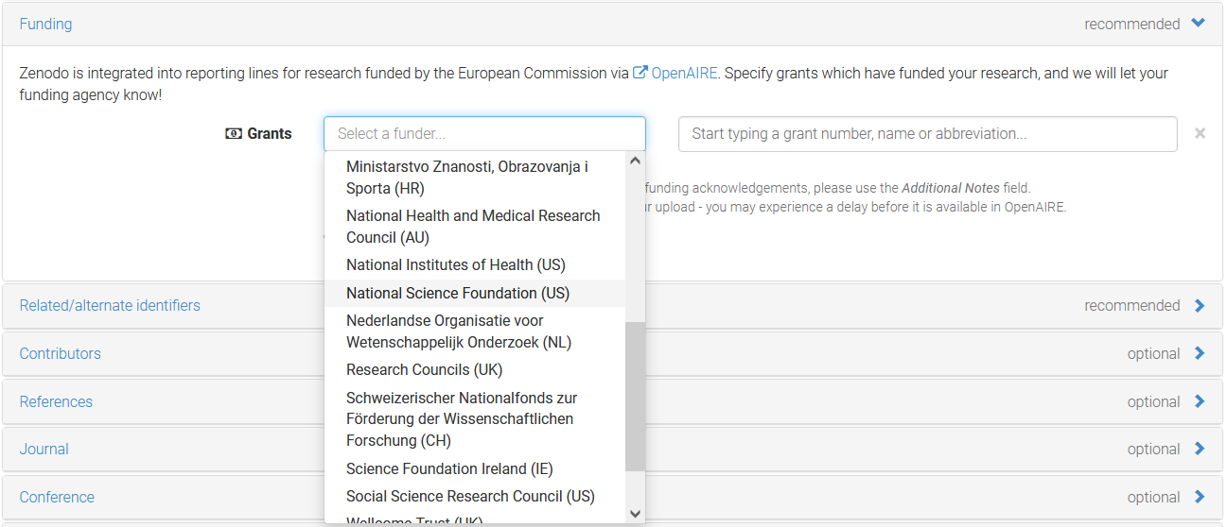
Required: Funding

Slide 17
If your grant does not show up...
Keywords: CZNet and your thematic cluster
Funding agency if not in database
Funding Agency:
Award Number:
Award Title:

Slide 18
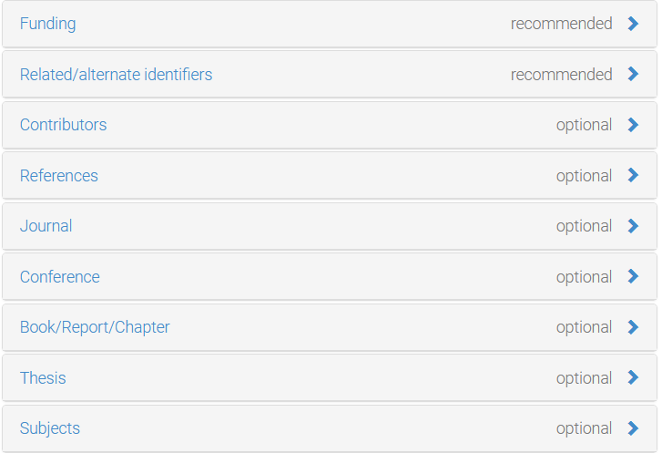
Additional/Optional Fields in Zenodo
Related/alternate identifiers
Contributors (drop down list of options)

Slide 19
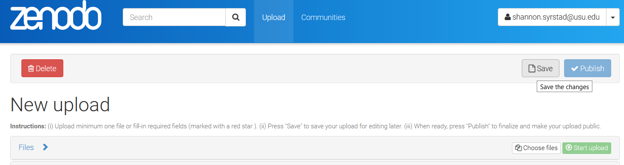
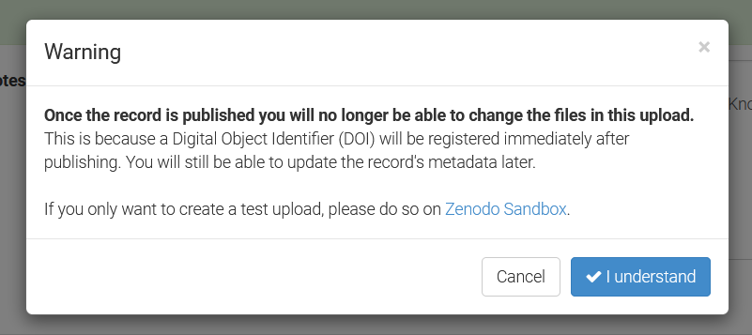
Save vs. Publish
When creating your entry, use Save button until you are 100% ready to publish your data.
Alternatively, use Zenodo Sanbox to upload/publish a test version. Sandbox.zenodo.org (has some limitations)
Ready to Publish? Hit Save, then hit Publish. Remember, once published:
Files are not editable (adding/removing files)
DOI is not editable
Metadata is editable
Can upload new file version, however

Slide 20
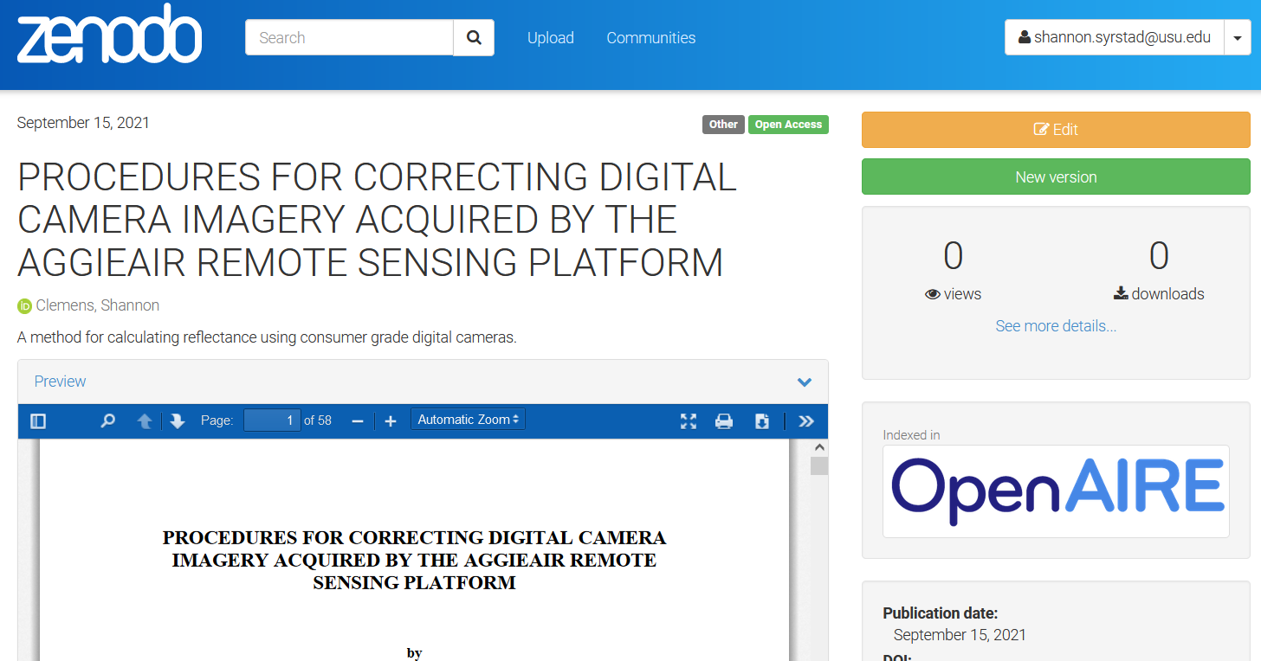
Uploading New Versions
Creating a new version is simpler than making a new upload. All versions of one record are easy to search and navigate.

Slide 21
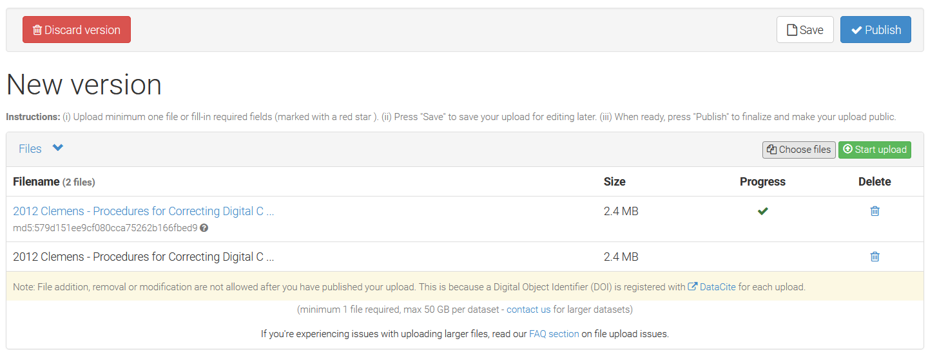
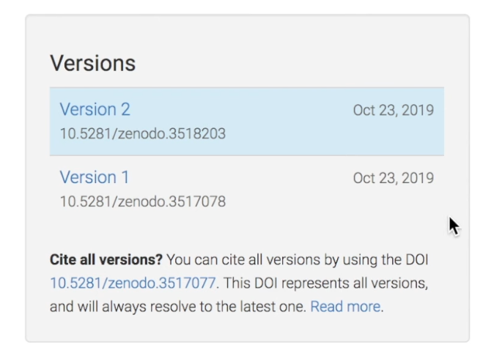

Slide 22
Uploading New Versions
What is DOI versioning?
Allows you to revise your datasets while adhering to data citation principles
Why not just add “.v2” to a DOI?
The “.v2” has no meaning for a machine in the DOI system. Instead Zenodo version DOIs are linked in a machine-readable metadata. Semantic info can change, while persistent identifiers should stay persistent!

Slide 23
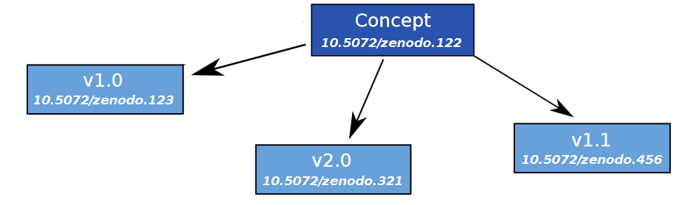
Uploading New Versions
How does it work?
Zenodo registers one DOI per version of your dataset, and also one Concept DOI.
The Concept DOI represents all the versions of a record and semantically links all the per-versions DOIs.
Cite an exact version for reliable reproducibility or cite all versions, even future ones.

Slide 24
Deleting a Record Once Published
Records can be deleted if saved only
Published records are tricky to delete!
DOIs are registered, Zenodo has obligation to keep the content, and only removes with valid justification (copyright infringement, exposure of data from human subjects, spam)
One month grace period with permission
Best to test in Sandbox.Zenodo.org or wait on to publish (it can still be public)

Slide 25
Additional Zenodo Help
https://help.zenodo.org/

Slide 26

Zenodo and Github
Integration between Zenodo and Github to make code citable
https://docs.github.com/en/repositories/archiving-a-github-repository/referencing-and-citing-content

Slide 27
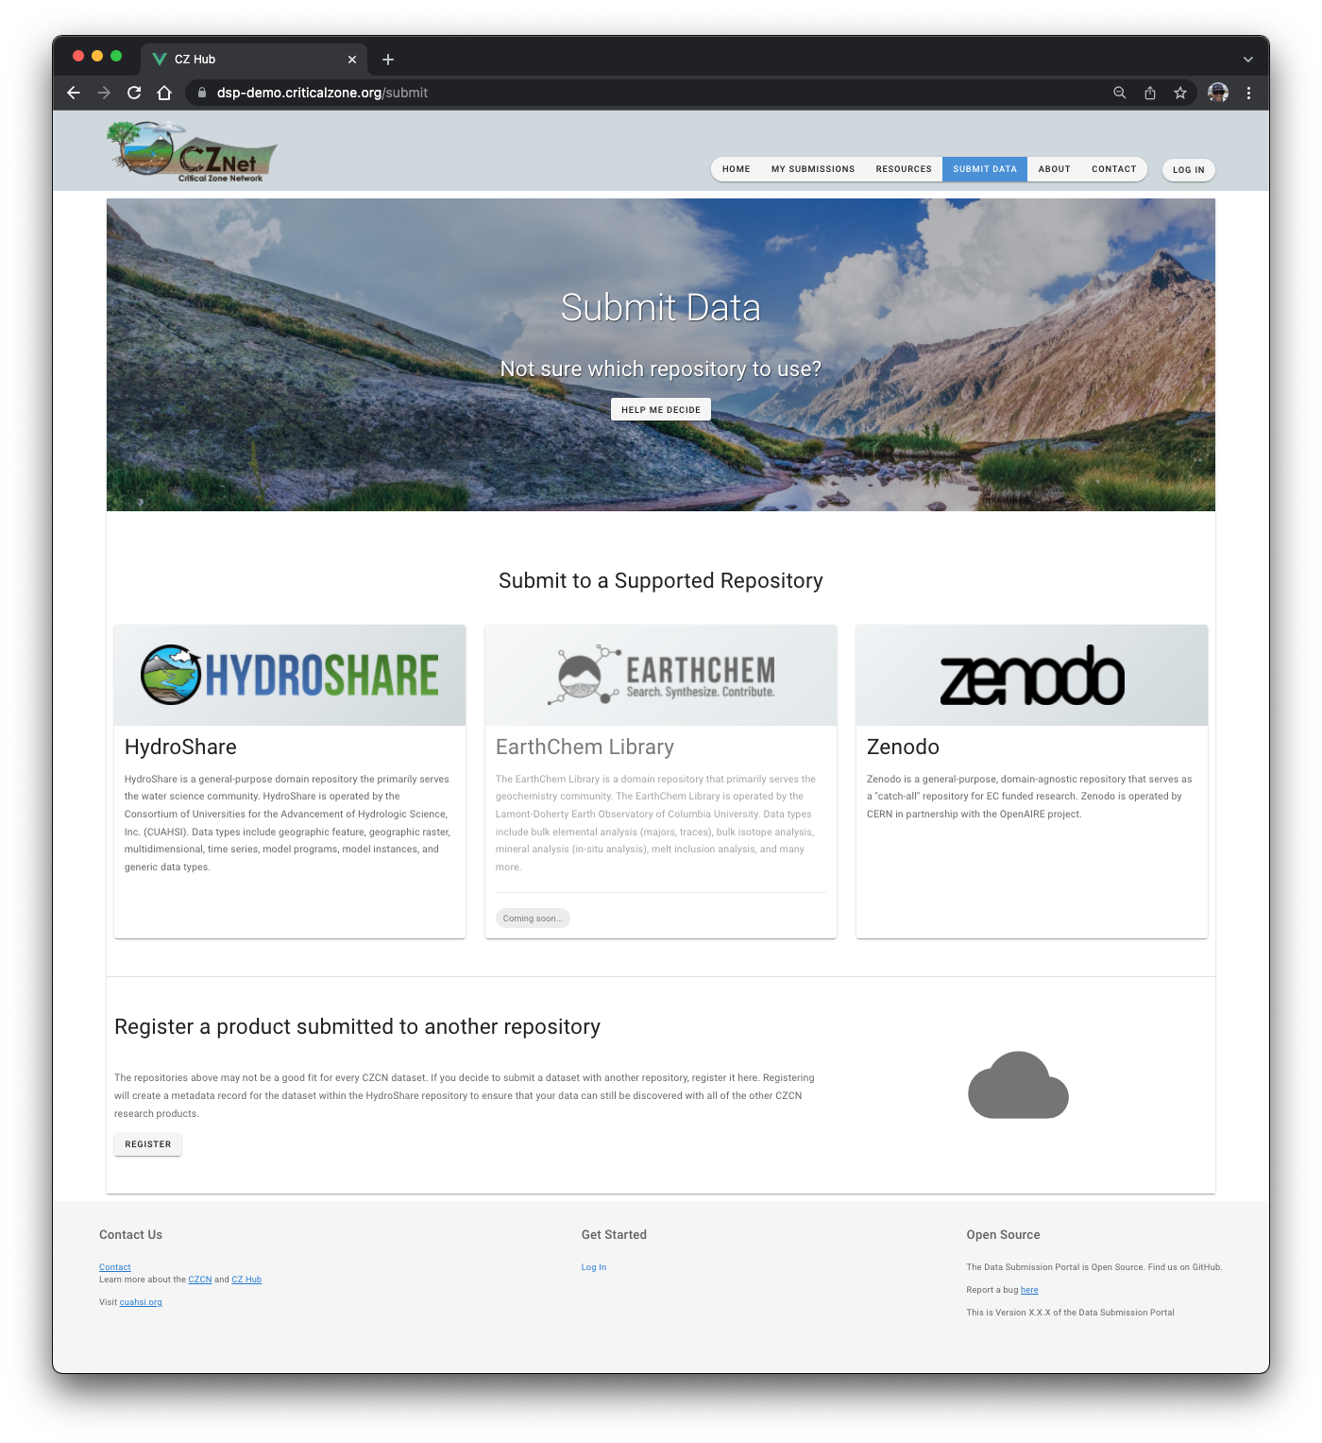
Zenodo and the CZ Hub Data Submission Portal
We will be supporting submission of data to Zenodo through the Data Submission Portal

Slide 28

Questions?
Contact us:
cznet@cuahsi.org

